Slide 1


Ministry of Higher Education and Scientific Research
University of Information Technology and Communication
Business Informatics College
Mobile Application For Image Labeling Based On Deep Learning API
Mustafa Fawzi Mustafa
Aya Hussien Aleabie
Supervision by: Dr.mohammed salih

Slide 2


Introduction
In Today’s Generation are much more depended on mobile applications. So the Mobile application development are very essential to any business organization .
Artificial Intelligence is an area of computer science that emphasizes the creation of intelligent machines that work and react like humans .

Slide 3
The problem of project
Approaches to sense real world objects are usually based on visual markers (e.g. QR-Codes or other 2D barcodes RFID tags). For certain types of objects, such as sights, buildings, and living beings marker based approaches are often not sensible or considerably restrict the interaction radius. Markerless approaches, for instance based on natural features, can overcome some of these limitations. However, the current Artificial Intelligence models, which is, recognize specific object need to a huge quantity of memory and making waste of power that indicates as consumption in power of smart phone .

Slide 4
The Aim of the Project
The aim of this project is to design and implement mobile app develops by Flutter framework (Hybrid app) and processes camera images per second and running on various platform (Android, IOS and windows). Furthermore, it has ability to recognize a huge amount of objects up to 8000 objects, text recognition , text translation and solve math equations based on Deep learning neural network model which is programmed in google cloud.

Slide 5
Native vs Hybrid app
Native app | hybrid app
Developed in platform specific language, objective-c or swift for ios, java for android,etc | Developed for cross platform , ionic or react native ,etc.
Separate code for each platform | Write once, run anywhere
Higher investment of time, talent and resources | Save time and money
Higher costs and development time | Faster development cycle

Slide 6
Flutter vs react native vs ionic
Flutter | Ionic | React native | Attribute
Dart | Html , Css , Typescript | JavaScript , Swift , Java or Objective-C | Programming language
Amazing | Moderate | Close to native | Performance
Use proprietary widgets and deliver amazing UI | Html , Css | Use native UI controllers | GUI
All apps | Simple apps | All apps | Use Cases
96% of code | 96% of code | 90% of code | Code Reusability

Slide 7
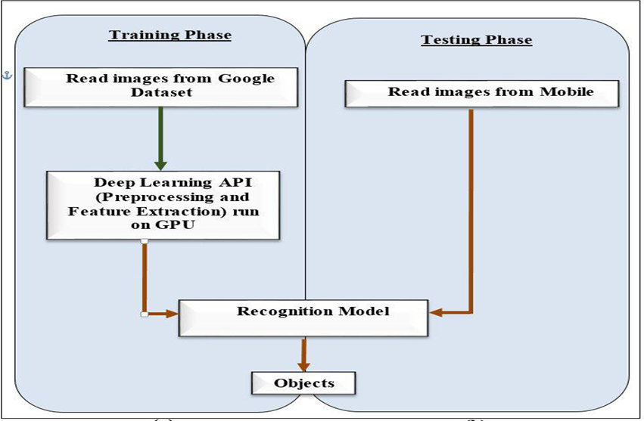
Proposal structure for mobile app

Slide 8
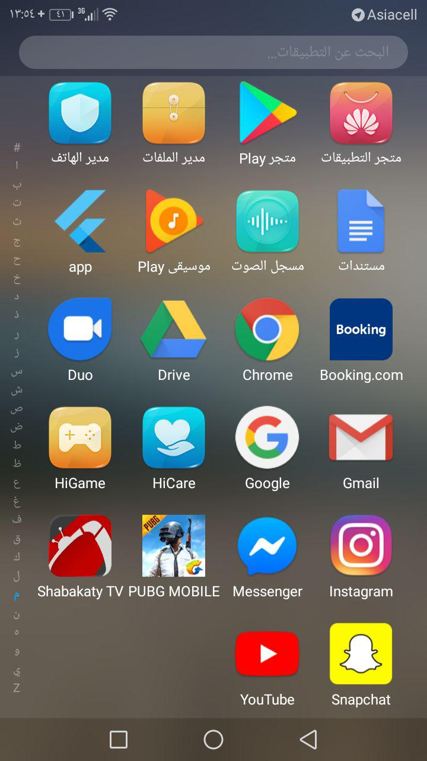
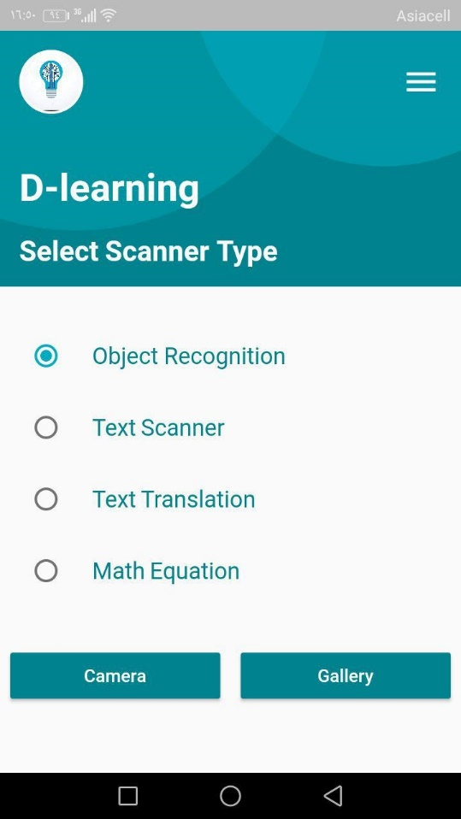
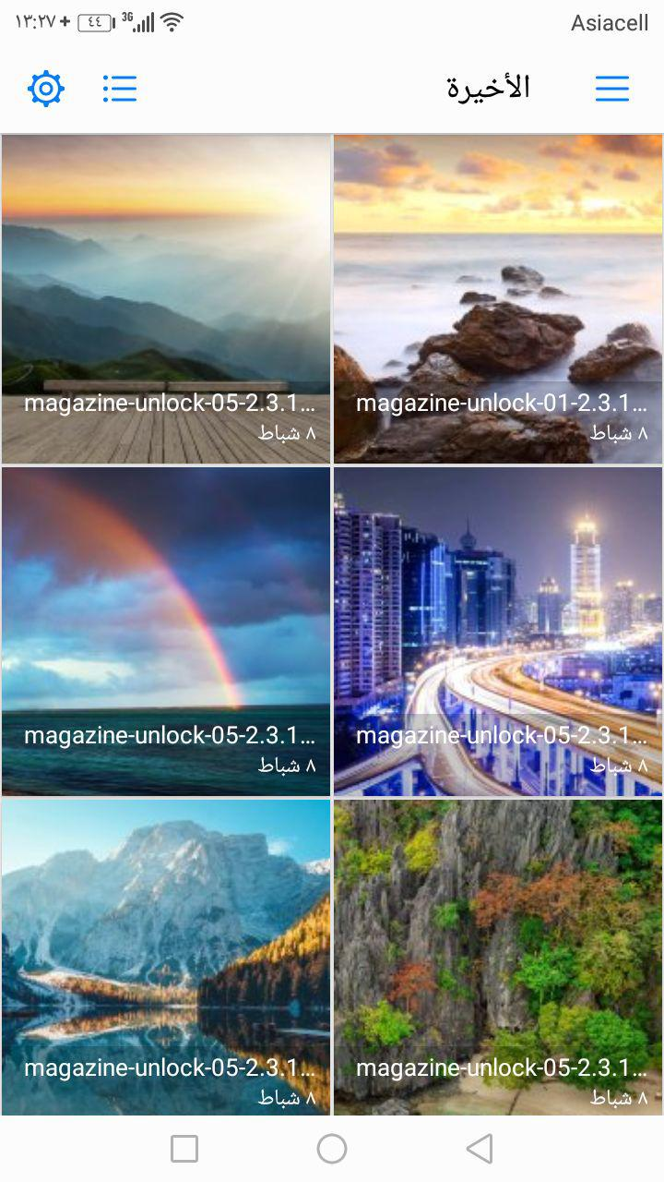
Open App
Choose Recognition Technique
Choose Image

Slide 9
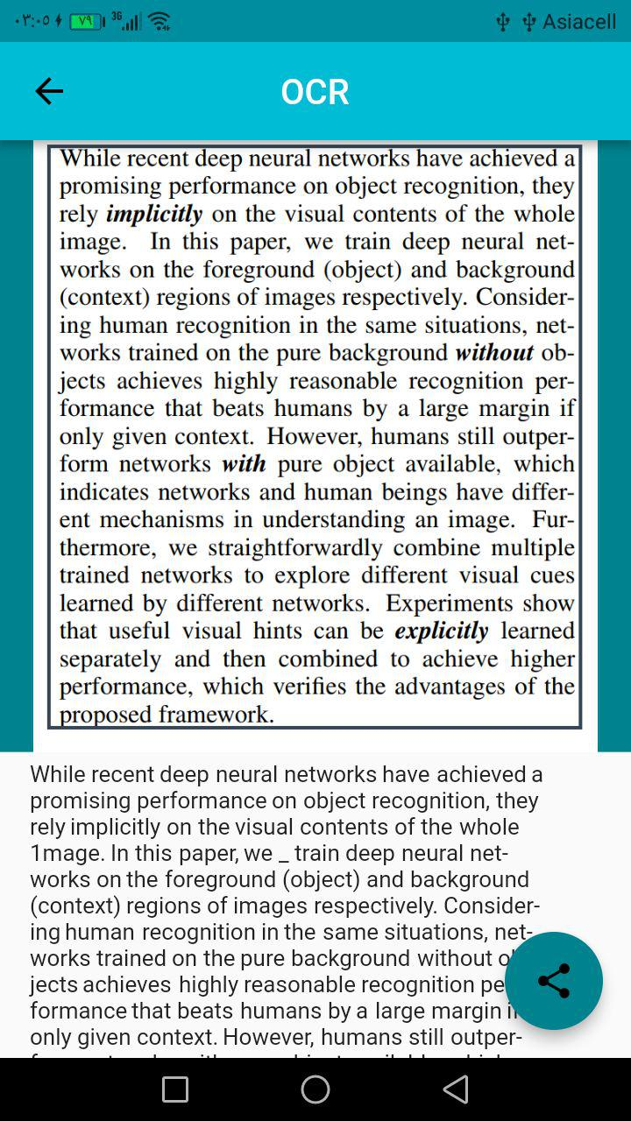
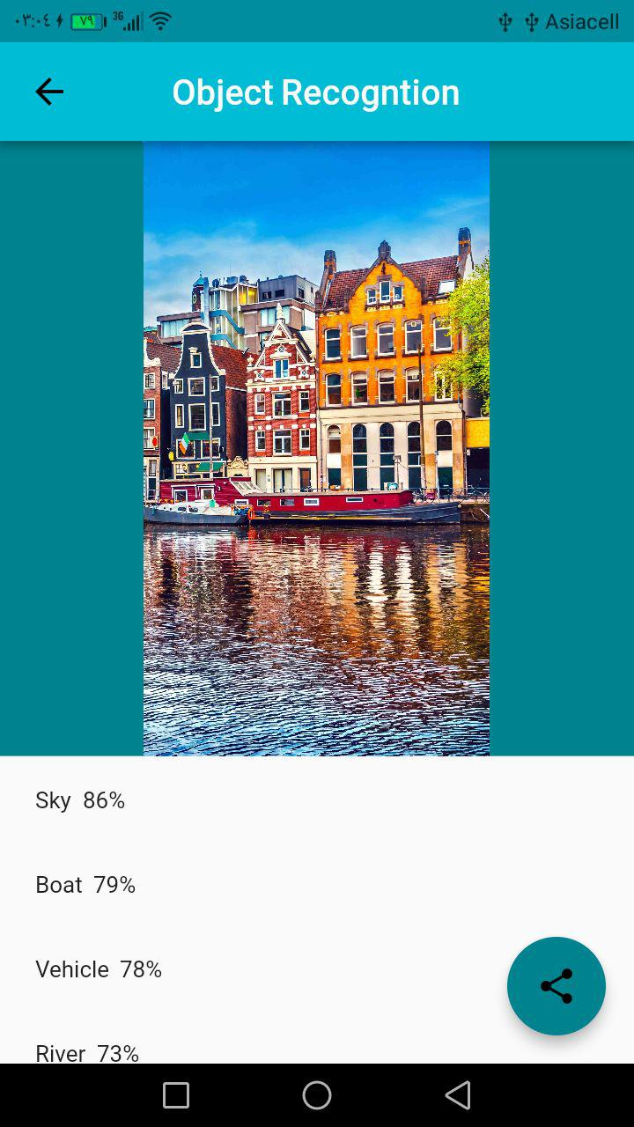
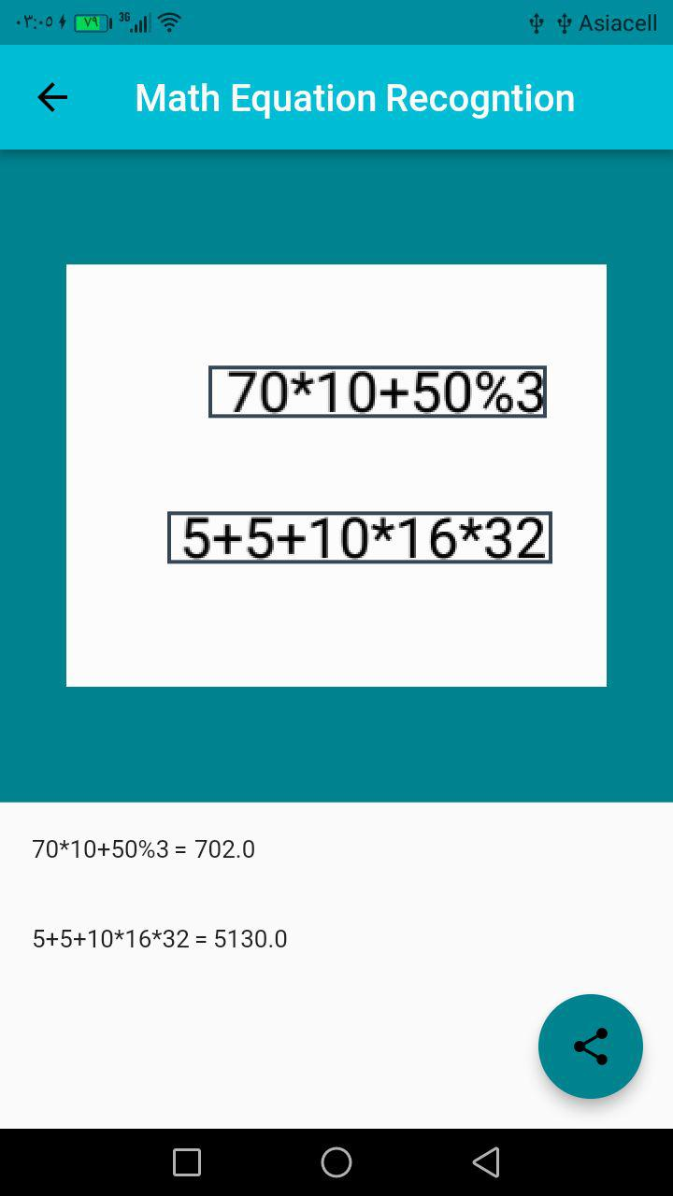
OCR
Object Recognition
Math Equation

Slide 10
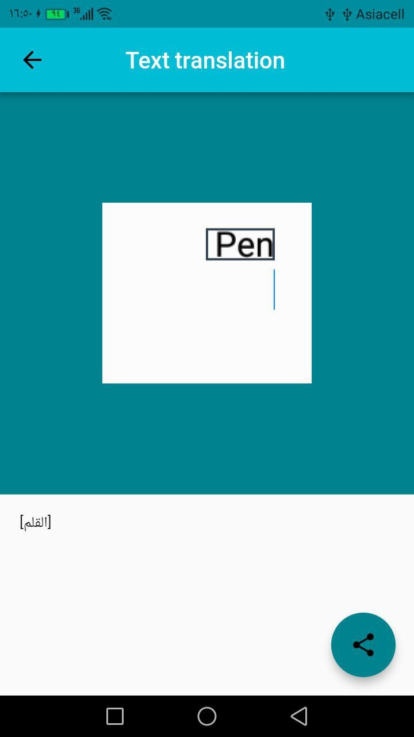
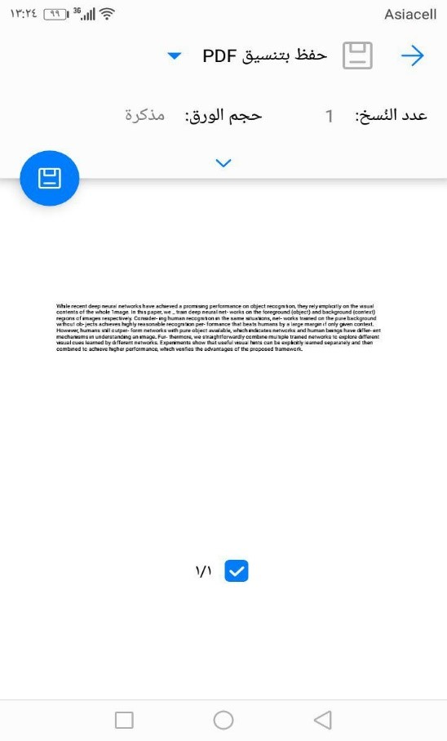
Text Translation
Shared button
Share interface

Slide 11
The Conclusions
In our project we made application with ability to recognized more than 3000 objects in approximate accuracy of 95% and we exceed the classical model limitations for object recognitions that recognized limit number of object, the app provide the confidence of each object recognized, also they have ability to recognized text in English language in approximate accuracy of 92% , the applications can also detection the mathematical equations and solve it, not only one equation in image, but also more than one equation in image, and the application can translate any text in image to Arabic language with approximate accuracy of 87%, also the application can shared result as pdf and word file that we have ability to modify it and also we can print result

Slide 12
Next Step …
Read label as sound.
Ability to solve complex math equations

